Slide 1

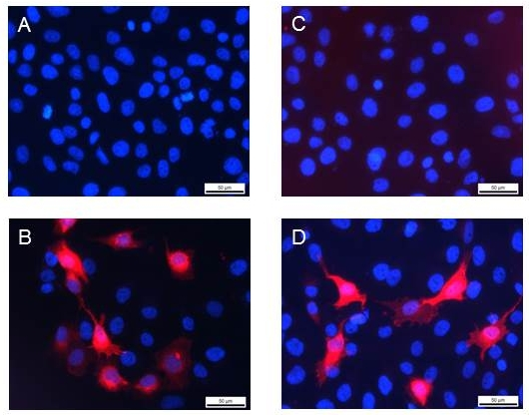
Reliatech GmbH
Mouse anti-human VEGFR-3/FLT-6
(Cat #101-M36)
Fig. 1: Immunofluorescence staining of human VEGFR-3/FLT-4 (red) in hFlt4-transfected MG63 cells. Monoclonal mouse anti-human FLT-4 #9D9 [Cat# 101-M36] and polyclonal rabbit anti-human FLT-4 (D) [Cat# 102-PA22]: A and C are negative control with secondary antibody only; B (mAb) and D (pAb) with specific antibodies against human FLT-4.
The experiment was performed by the research group of Dr. Wolfgang Holnthoner, Ludwig Boltzmann Institute for Experimental and Clinical Traumatology, Austrian Cluster for Tissue Regeneration, Donaueschingenstrasse 13, A-1200 Vienna, Austria
http://www.reliatech.de / orders@reliatech.de

